Slide 1

Analysis of Breast Cancer Detection using Ensemble Method
Phase II - Review 2
Under the guidance of
Prof. Annapoorna B.R
Computer Science Department
Dayananda Sagar College of Engineering.
Team Members
1. Shalini Singh (1DS19CS146)
2. Kota V Vishnu (1DS19CS723)
3. Reena Jasmine Edwin (1DS19CS738)
4. S Sai Brinda (1DS19CS741)
Department of Computer Science & Engineering, DSCE

Slide 2
Introduction to the Problem
Breast cancer is the leading cause of cancer deaths in women worldwide, with 2.26 million cases in 2020 according to WHO.
Early detection of breast cancer is important because it can increase the chances of successful treatment and survival.
Machine learning and Artificial Intelligence are being used more frequently as diagnostic tools for identifying breast cancer.
Department of Computer Science & Engineering, DSCE

Slide 3
Several tests, including clump thickness, cell size, and cell shape, are used to identify breast cancer, but it can still be difficult to get a definite result even for medical professionals.
The goal of this study is to investigate the use of various machine learning algorithms for early breast cancer diagnosis using the Wisconsin breast cancer dataset.
To compare the performance of these algorithms using classification techniques such as Naïve Bayes, KNN, Random Forest, and SVM, and evaluate their accuracy using metrics such as recall, precision, F1 score, and accuracy percentage.
Department of Computer Science & Engineering, DSCE

Slide 4
Contribution of Each project Members
Shalini Singh (1DS19CS146) Implementation of Random Forest Algorithm and XGBoost Ensemble Model | Kota V Vishnu (1DS19CS723) Implementation of Naïve Bayes Algorithm and XGBoost Ensemble Model
Reena Jasmine Edwin (1DS19CS738) Implementation of Support Vector Machine Algorithm and XGBoost Ensemble Model | S Sai Brinda (1DS19CS741) Implementation of K Nearest Neighbor Algorithm and XGBoost Ensemble Model

Slide 5
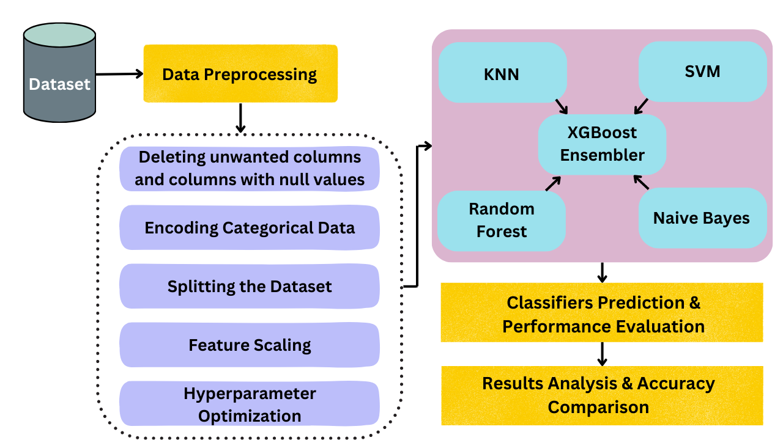
System Design / Architecture
Department of Computer Science & Engineering, DSCE

Slide 6
Modules
Problem Identification and Data Collection
Data Pre-processing
Implementation of individual ML models
Analysing the model performance
Building an ensemble model
Analysing the ensemble model performance

Slide 7
Modules Description
1.Problem Identification and Data Collection:
Analysing aspects of current breast cancer detection method and collecting data from where it can be improved.
2.Data Pre-processing
The Data Collected is processed according to parameters which the developer would most likely get a higher rate of accuracy and precision.
3.Implementation of individual ML models
Individual ML models are used and the results of each algorithm is noted down.

Slide 8
Modules Description
4 . Analysing model performance:
The results of each algorithm is mentioned and noted down
5. Building Ensemble Model:
Results of the multiple algorithms are used to produce a singular definitive method of analysis.
This obtained result has a better accuracy than individual models.
6.Performance of Ensemble Model:
The results from the ensemble model is noted down

Slide 9
Input
The dataset used for this project is Wisconsin-Breast Cancer (Diagnostics) dataset.
There are two classes, benign and malignant.
Dataset Shape-(569,33)
Out of 569 samples 357 are benign and 212 are malignant.
Source-Kaggle https://www.kaggle.com/datasets/uciml/breast-cancer-wisconsin-data
Department of Computer Science & Engineering, DSCE

Slide 10
Data Pre-processing
Deleting unwanted columns and columns with null values: Out of the 33 attributes in the Wisconsin dataset, “id” and “unnamed:32” columns are dropped. Encoding Categorical Data: Machine learning model completely works on mathematics and numbers, but if our dataset would have a categorical variable, it is necessary to encode these categorical variables into numbers. Diagnosis column has ‘M’ and ‘B’ as values in the dataset, which is then mapped to 1 and 0 respectively.
Department of Computer Science & Engineering, DSCE

Slide 11
Splitting the Dataset: we can enhance the performance of our machine learning model by dividing our dataset into a training set and test set.
Feature Scaling: A machine learning model is based on Euclidean distance, and if we do not scale the variable, then it will cause some issue in our machine learning model.
It is a technique to standardize the independent variables of the dataset in a specific range. In feature scaling, we put our variables in the same range and in the same scale so that no any variable dominate the other variable.
Department of Computer Science & Engineering, DSCE

Slide 12
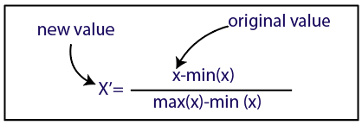
Normalization:
Hyperparameter Optimization: At a particular value of your parameter, the accuracy will be the maximum. Parameter tuning refers to finding these values. Eg: GridSearchCV ,RandomizedSearchCV
Department of Computer Science & Engineering, DSCE

Slide 13
Algorithm
We have visualized the Wisconsin Breast Cancer Dataset and pre-processed it for making it suitable as input to our algorithms
Using seaborn library the relationship between features was visualized
Using heatmap the correlation between features is represented.
Department of Computer Science & Engineering, DSCE

Slide 14
Algorithm
The four different algorithm used :
Random Forest
SVM
KNN
Naïve Bayes
We have algo use hyperparameter tunning methods
for better results

Slide 15
Algorithm
The result is shown by calculation of accuracy and confusion matrix.
On the basis of result obtained we will further select three best algorithm as input to ensemble model
.

Slide 16

Output
The table above shows accuracy of all models individually ,their Precision and Recall .Upon creating an ensemble model the accuracy increases to 97.71%.
Department of Computer Science & Engineering, DSCE

Slide 17
Conclusion
The workable aspect of this project is to make an effective diagnosis system for breast cancer patients using the data in the benchmark database WBCD.
We investigated all classifier’s performance on patient’s data parameters and the SVM, RF gives the highest classification accuracy of 96.49 % to predict the breast cancer and Naïve Bayes gives the lowest accuracy of 94.7% among the classifiers, whereas XGBoost Ensemble Model built using all classifiers gives 97.71% outperforming all others individual models.
Therefore, machine learning will play an important role in health care research and as well as medical centre’s to early prediction of breast cancer.
Department of Computer Science & Engineering, DSCE

Slide 18
Future Enhancement
We intend to conduct an in-depth study of these datasets by combining ML techniques with deep learning models on the application of more complex deep learning architectures to achieve better performance.
In addition, we test our in-depth learning approach on larger data sets with more disease classes to achieve higher accuracy.
Another future research direction would be to build UI for the work carried out so it makes easy to analyze results visually.
Department of Computer Science & Engineering, DSCE

Slide 19
Co-Guide Meet Details
Meet 1 (Jan 10 2023) Explained about the Project. She felt our project methodology was feasible and asked us to show progress in next review.
Meet 2 (Jan 25 2023) Presented our Literature survey and showed individual ML models implementation. She was happy with the progress.
Meet 3 (Apr 9 2023) Presented the individual implementations into single Jupyter Notebook and sought guidance regarding train-test split ratio and Hyperparameter Optimization. She Advised to use 70:30 ratio and remove hyperparameter optimization for those models, where it is decreasing the accuracy of the model.
Department of Computer Science & Engineering, DSCE

Slide 20
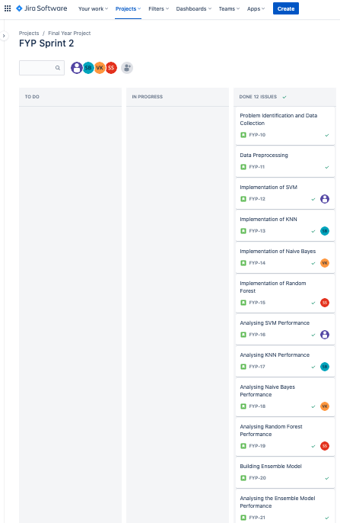
Project Tool Snapshot
Department of Computer Science & Engineering, DSCE

Slide 21
THANK YOU!
Department of Computer Science & Engineering, DSCE

